Slide 1
Project 30- Medical Image Captioning System
Team Members
Aline Uchoa de Araujo - 2207844
Joona Kontiokoski
Mohammad Azizul Kawser - 2207846

Slide 2
Abstract
The Medical Image Captioning System is a creative solution that leverages cutting-edge deep learning techniques. In this project, we delve into the combination of computer vision and natural language processing to generate descriptive and clinically meaningful captions for medical images. The core of this system lies in its ability to employ neural networks using state-of-the-art Convolutional Neural Networks (CNNs). The system extracts visual features from medical images, ranging from X-rays to MRIs. These features serve as the foundation for a Recurrent Neural Network (RNN), which translates the visual cues into coherent and informative textual descriptions. A specialized ROCO dataset, containing 81K radiology images encompassing a wide array of medical images with captions, serves as the foundation for this project. The project’s workflow encompasses data preprocessing, feature extraction, vocabulary creation, training neural network models, and the evaluation of the models. Upon completion, this system promises transformative implications for the healthcare landscape. From aiding radiologists in rapid image interpretation to facilitating medical education through visually augmented learning materials. Furthermore, the generated captions can be harnessed for comprehensive medical documentation, contributing significantly to the efficiency and accuracy of patient records.

Slide 3
Topic(s) investigated
Relevant prior work
Data Preparation and Visualization
Downloading and organizing dataset.
Visualizing dataset.
Encoder-Decoder Model Architecture
Encoder model using CNNs for feature extraction
Decoder model using LSTMs for sentence generation
Natural Language Processing (NLP)
Normalization, Stopword removal, Tokenization, stemming
Word Occurrence Analysis, Word Embeddings, Vocabulary Creation
Evaluation Metrics
Calculating the similarity between newly generated captions and original captions
Optimization and Scalability
Hyper-parameter tuning, Pruning
Pelka, O., Koitka, S., Rückert, J., Nensa, F., & Friedrich, C. M. (2018). Radiology Objects in COntext (ROCO): A Multimodal Image Dataset. https://doi.org/10.1007/978-3-030-01364-6_20
Beddiar, D., Oussalah, M., & Tapio, S. (2022). Explainability for Medical Image Captioning. 2022 Eleventh International Conference on Image Processing Theory, Tools and Applications (IPTA), 1–6. https://doi.org/10.1109/IPTA54936.2022.9784146
Beddiar, D. R., Oussalah, M., Seppänen, T., & Jennane, R. (2022). ACapMed: Automatic Captioning for Medical Imaging. Applied Sciences, 12(21), Article 21. https://doi.org/10.3390/app122111092
Beddiar, D.-R., Oussalah, M., & Seppänen, T. (2023). Automatic captioning for medical imaging (MIC): A rapid review of literature. Artificial Intelligence Review, 56(5), 4019–4076. https://doi.org/10.1007/s10462-022-10270-w
Selivanov, A., Rogov, O. Y., Chesakov, D., Shelmanov, A., Fedulova, I., & Dylov, D. V. (2023). Medical image captioning via generative pretrained transformers. Scientific Reports, 13(1), Article 1. https://doi.org/10.1038/s41598-023-31223-5
Xu, L., Tang, Q., Lv, J., Zheng, B., Zeng, X., & Li, W. (2023). Deep image captioning: A review of methods, trends and future challenges. Neurocomputing, 546, 126287. https://doi.org/10.1016/j.neucom.2023.126287
Cui, Y., Yang, G., Veit, A., Huang, X., & Belongie, S. (2018). Learning to Evaluate Image Captioning (arXiv:1806.06422). arXiv. https://doi.org/10.48550/arXiv.1806.06422

Slide 4
Group member responsibilities
Data source & Technologies
Data Preparation and Visualization - Joona & Kawser
Vocabulary Creation and Text Preprocessing - Aline & Joona
Encoder-Decoder Model Architecture (CNN & RNN)- Kawser & Joona
Data Loading and Training Setup - Joona
Model Testing, Optimization and Evaluation - Joona, Kawser & Aline
Literature Review, Presentation & Report Writing - Aline, Kawser & Joona
Radiology Objects in Context (ROCO) dataset
Image Modalities: 81,825 radiology images including Computer Tomography (CT), Ultrasound, X-Ray, Fluoroscopy, Positron Emission Tomography (PET), Mammography, Magnetic Resonance Imaging (MRI), and Angiography.
Out-of-Class Samples: Includes 6,127 out-of-class samples. Range from synthetic radiology figures to digital art and portraits.
Metadata: Image metadata includes captions, keywords, Unified Medical Language Systems (UMLS) Concept Unique Identifiers (CUIs), and Semantic Types (SemTypes).
Technologies Used:
1. Programming Languages: Python
2. Frameworks: PyTorch, Scikit-learn
3. Neural Network Architectures: Pre-trained CNN architectures resnet50 and densnet121. RNN architectures LSTM
4. NLP Libraries: NLTK and SpaCy
6. Evaluation Metrics: BLEU , ROUGE, and METEOR
8. Version Control and Collaboration: Google Colab & Github

Slide 5
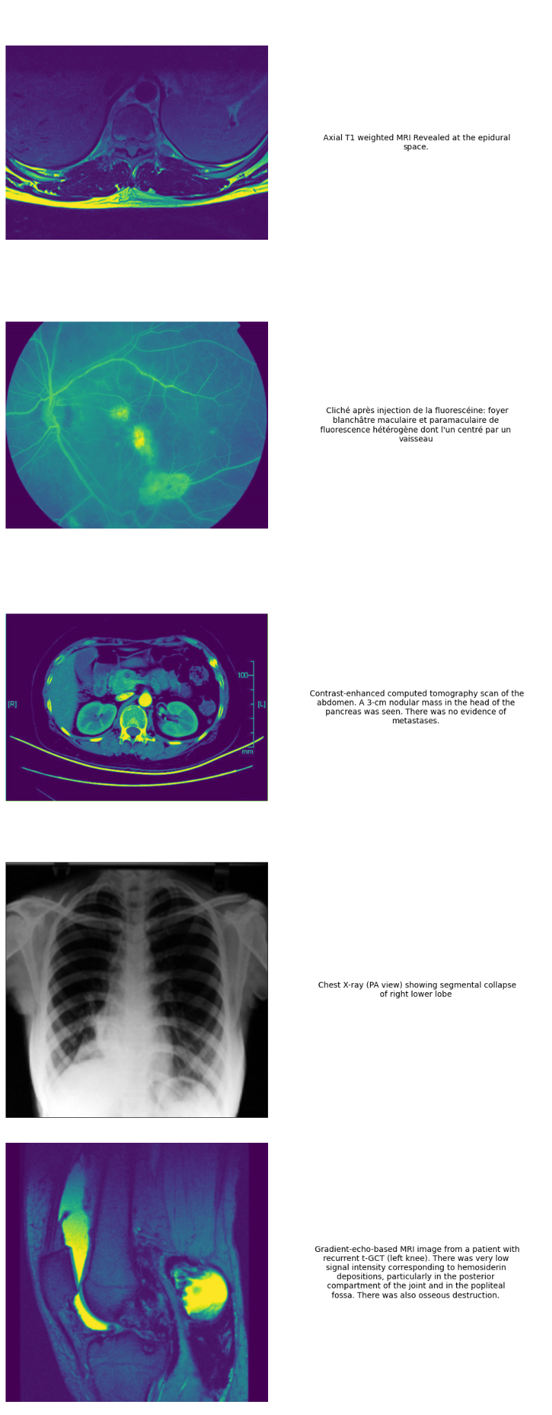
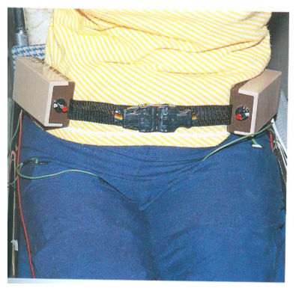
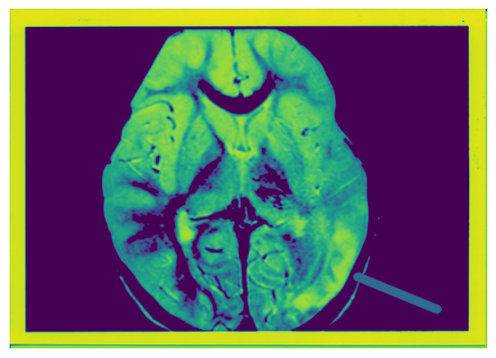
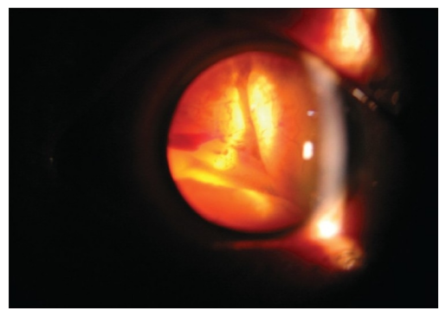
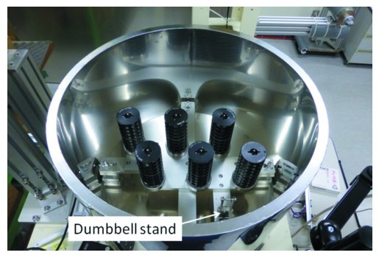
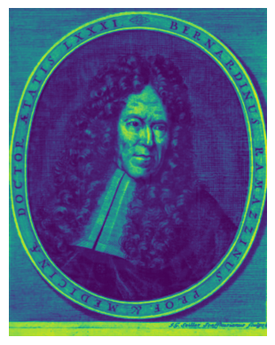
Current results so far
Task 1: Download the dataset and visualize some training image/caption
Radiology Image
Non-radiology Image
Chest X-ray (PA view) showing segmental collapse of right lower lobes
Axial T1 weighted MRI Revealed at the epidural space.
Gradient-echo-based MRI image from a patient with recurrent t-GCT (left knee). There was very low signal intensity corresponding to hemosiderin depositions, particularly in the posterior compartment of the joint and in the popliteal fossa. There was also osseous destruction.
We can see some radiology images in the Non-radiology image folder
Cliché après injection de la fluorescéine: foyer blanchâtre maculaire et paramaculaire de fluorescence héterogène don’t I'un centré par un vaisseau
Contrast-enhanced computed tomography scan of the abdomen. A 3-cm nodular mass in the head of the pancreas was seen. There was no evidence of metastases.
Note: There is no unique identifier found among non-radiology images and captions

Slide 6
Current results so far
Task 1: Download the dataset and visualize some training image/caption
Radiology Image
Non-radiology Image
Chest X-ray (PA view) showing segmental collapse of right lower lobes
Axial T1 weighted MRI Revealed at the epidural space.
Gradient-echo-based MRI image from a patient with recurrent t-GCT (left knee). There was very low signal intensity corresponding to hemosiderin depositions, particularly in the posterior compartment of the joint and in the popliteal fossa. There was also osseous destruction.
We can see some radiology images in the Non-radiology image folder
Note: There is no unique identifier found among non-radiology images and captions

Slide 7
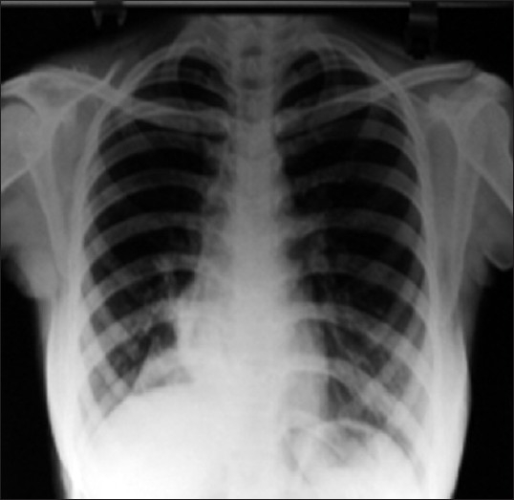
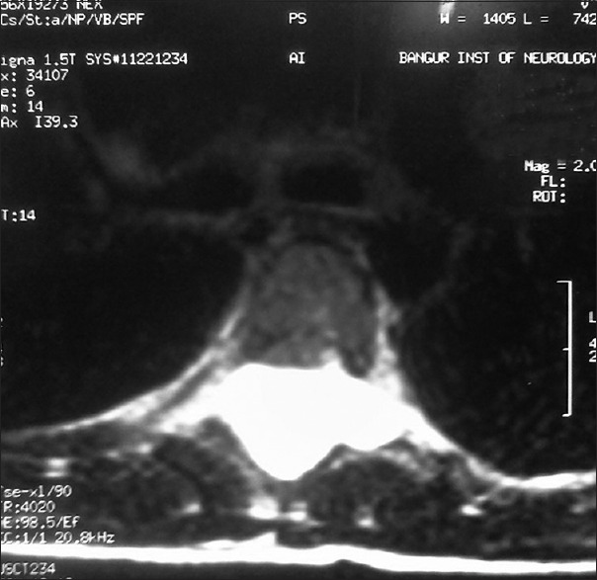
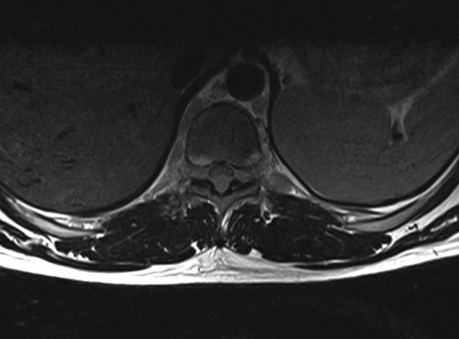
Magnetic resonance T2 weighted image showing foraminal extensions of the cysts
Axial T1 weighted MRI Revealed at the epidural space.
Chest X-ray (PA view) showing segmental collapse of right lower lobes

Slide 8
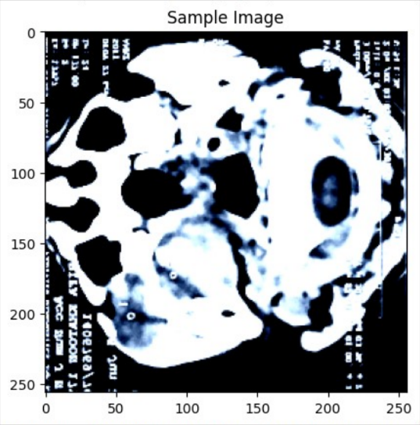
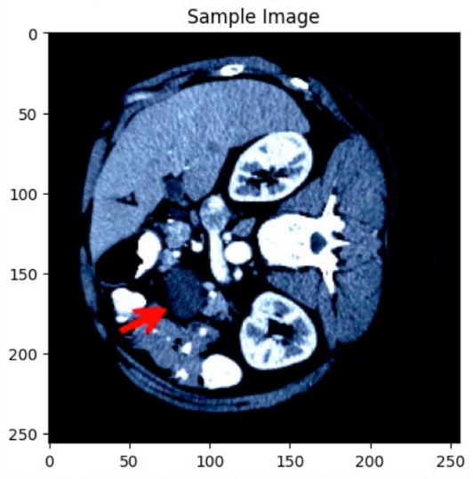
tee midesophageal av shortaxis view showing unicuspid aortic valve single posterior commissure arrowhead raphe yellow arrow eccentric orifice systole red arrow la left atrium ra right atrium
transthoracic echocardiogram parasternal long axis view showing right atrial appendage right ventricle rv right ventricle rv right ventricle rv right
BLEU score: 0.21379929763652455
METEOR score: 0.09716941275876638
NIST score: 0.48788907337992354
Test Image 3:
Original: constrastenhanced computed tomography shows space occupying lesion involving oropharynx nasopharynx parapharyngeal space extension cheek mandible
Generated: computed tomography scan showing large hypodense iliopsoas fluid collections white arrows
Test Image 4:
Original: ct scan abdomen shows cm cystic lesion arrow bodytail pancreas changes acute chronic pancreatitis
Generated: ct scan showing herniation omentum umbilical port side

Slide 9
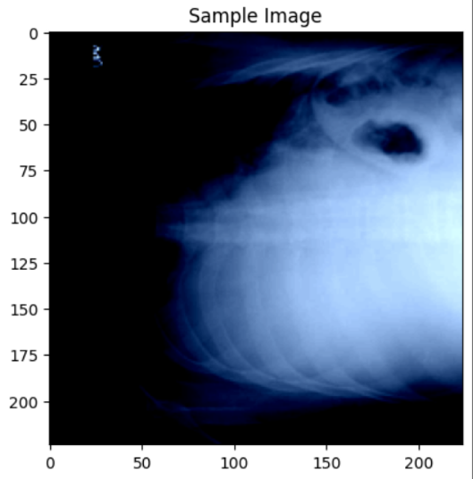
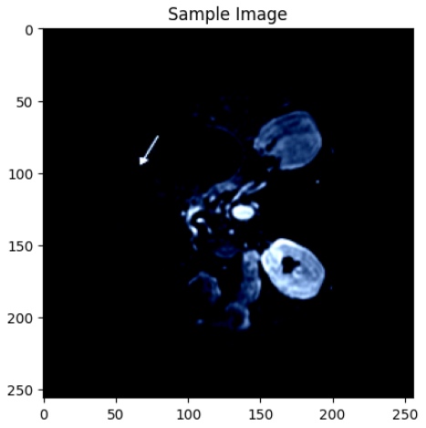
Test Image 7:
Original: mri axial view abdomen showing left hepatic lobe mass white arrow
Generated: ct scan showing herniation omentum umbilical port site
Test Image 8:
Original: chest radiograph showing moderate right pleural effusion
Generated: chest xray showing bilateral left pleural effusion

Slide 10
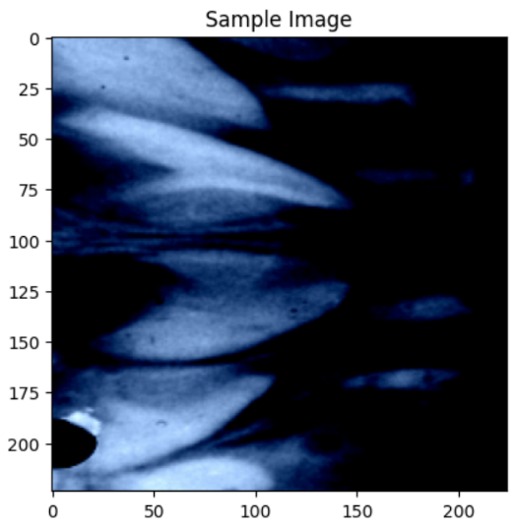
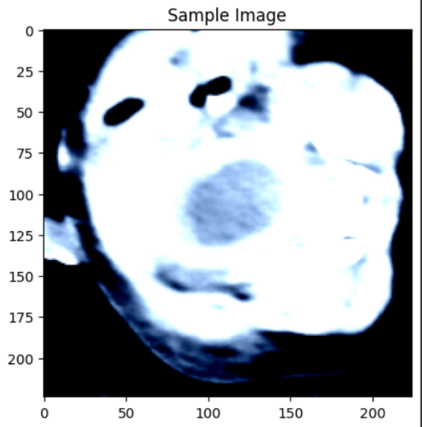
Test Image 5:
Original: postoperative radiograph
Generated: postoperative radiograph showing bilateral left
Test Image 6:
Original: ct scan shows welldefined cystic mass pelvis
Generated: postoperative ct scan showing bilateral right lung

Slide 11
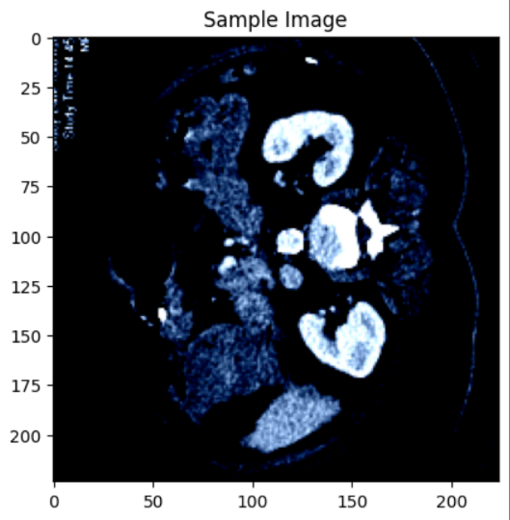
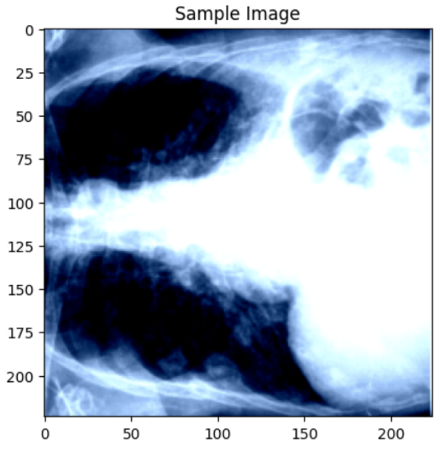
Test Image 2:
Original: abdominal ct scan revealed right upper quadrant mass
Generated: ct scan showing bilateral mass right
Test Image 1:
Original: chest radiograph showing pleural effusion left
Generated: chest xray showing bilateral left pleural effusion

Slide 12
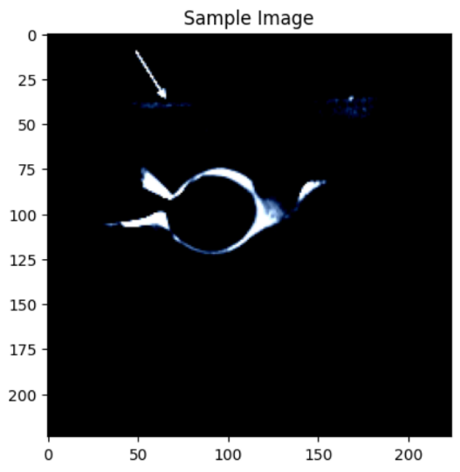
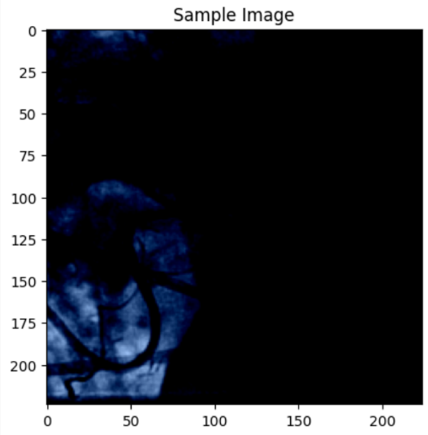
Test 9:
Original: magnetic resonance fat sat image fluid olecranon bursa
Generated: magnetic resonance imaging showing bilateral left atrium
Test 10:
Original: left internal mammary artery anastomosed left anterior descending artery
Generated: coronary angiography showing large left anterior artery artery artery artery

Slide 13
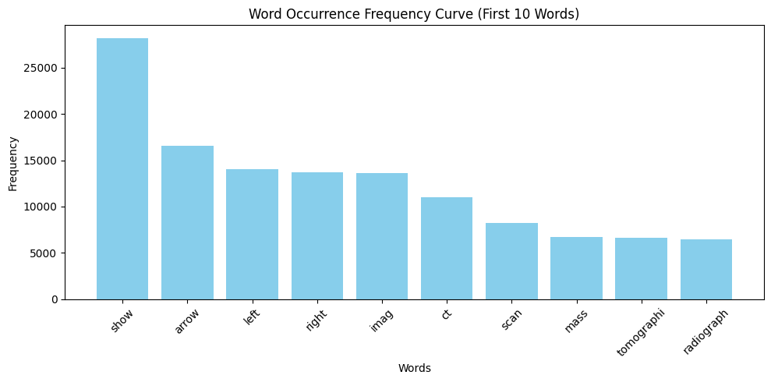
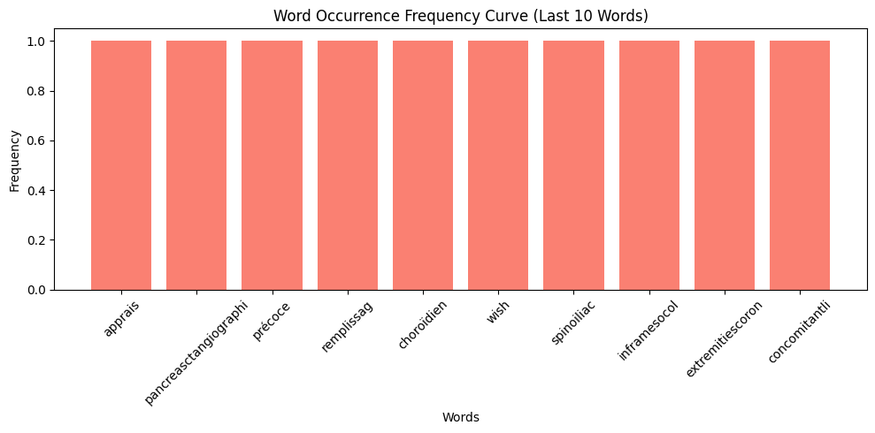
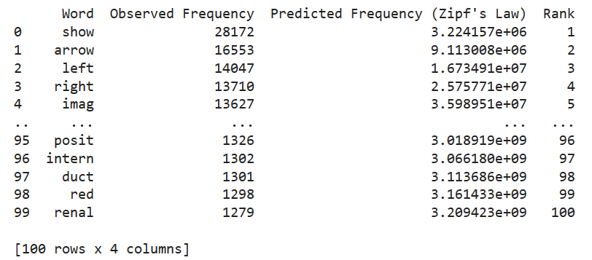
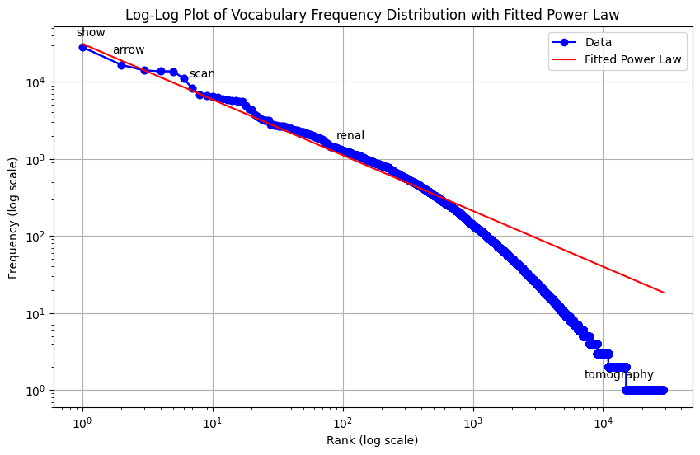
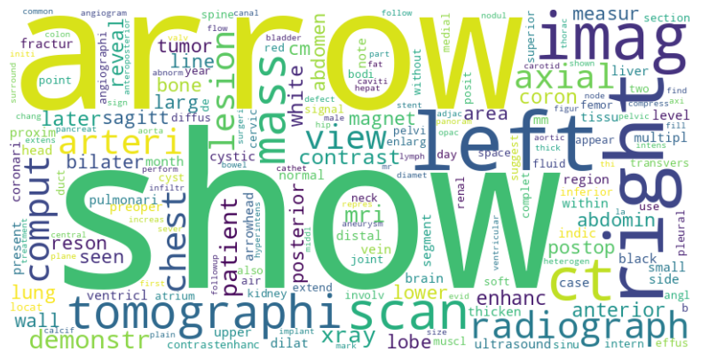
Current results so far
Task 3: Create the vocabulary a. clean the captions b. Plot the word occurrence
Notes:
In first image we see the 10 most and least frequent words and their frequencies. We also see the frequencies of words in a corpus is inversely proportional to their ranks.In simpler terms, if we rank all words by their frequency of occurrence, the most common (e.g Show) word appear approximately twice as often as the second most common word (e.g arrow) and so on. And it is also supported by the Log-Log Curve. The curve is about a straight line which indicates that the data follows Zipf's Law. This implies that a small number of words are very common, while the majority of words are rare.

Slide 14
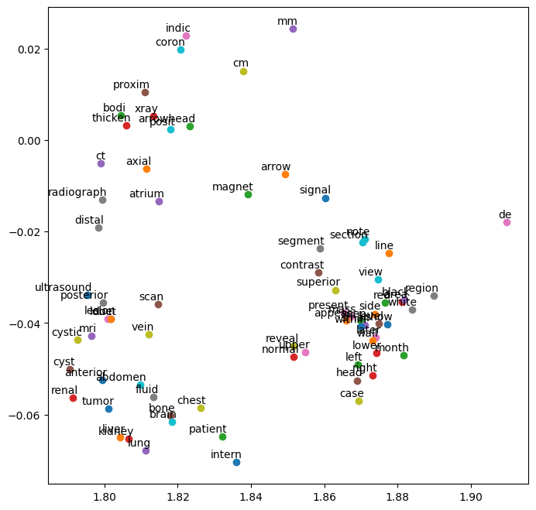
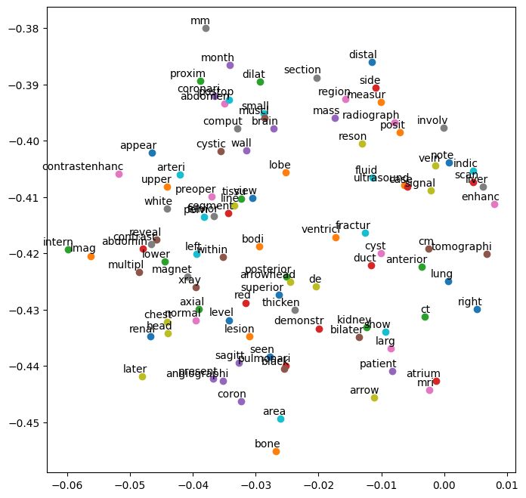
Current results so far
Task 3: Create the vocabulary c. Calculate embeddings d. Visualize word embedding space
GloVe
Word2vec
Visualizing 100 most frequent words in word embedding space
Notes:
Word embedding gives us insights into how words are represented in a high-dimensional space. Here we tried Glove and Word2Vec and In each case each word is associated with a 50-dimensional vector. Here , we visualize the embeddings in a 2D space using t-SNE dimensionality reduction technique (t-distributed Stochastic Neighbor Embedding). In this space, each dimension captures a certain aspect of the word's meaning or context. Words are scattered in the 2D space, providing a visual representation of the relationships between words based on their embeddings. In the plot, words that are in similar meaning or frequently co-occur in medical contexts are positioned closely together, while dissimilar words are farther apart.

Slide 15
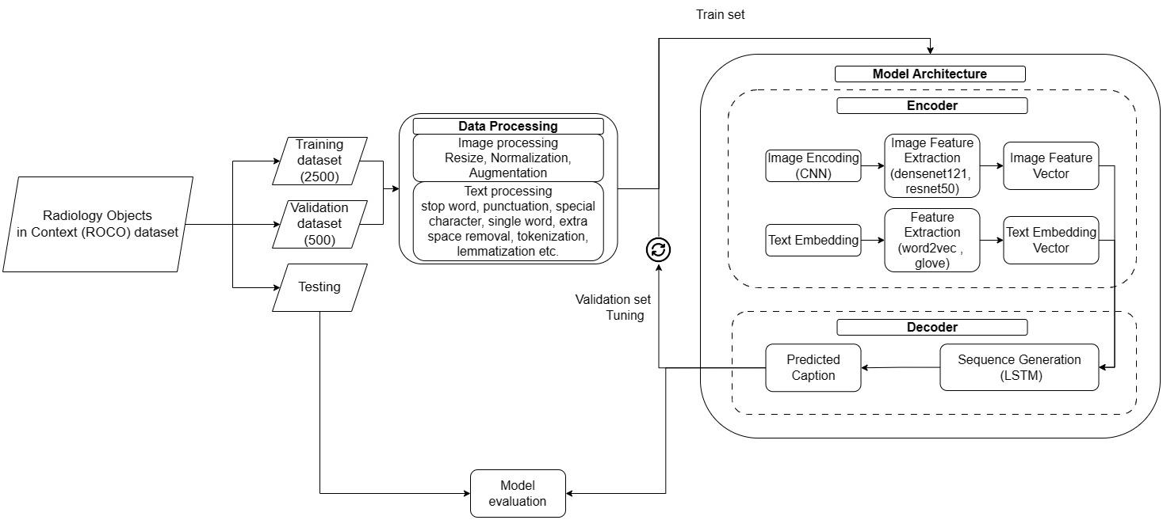
Implementation details

Slide 16
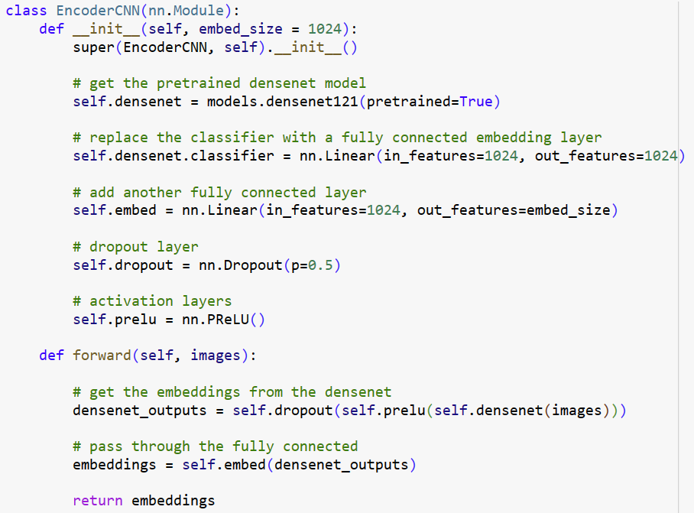
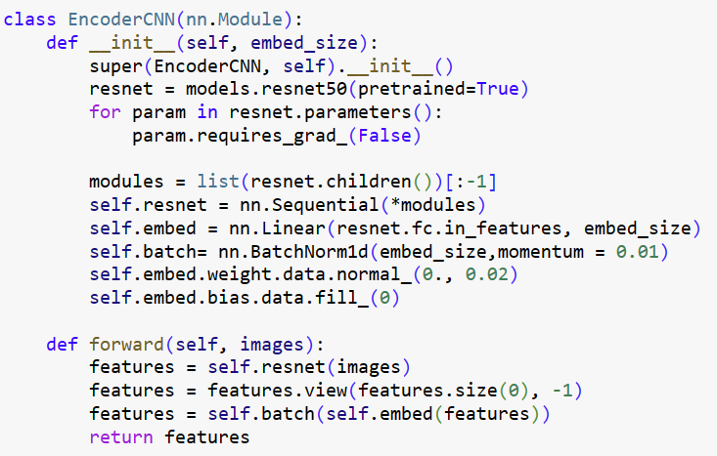
Current results so far
Task 2: Encoder-decoder architecture
densenet121
resnet50

Slide 17
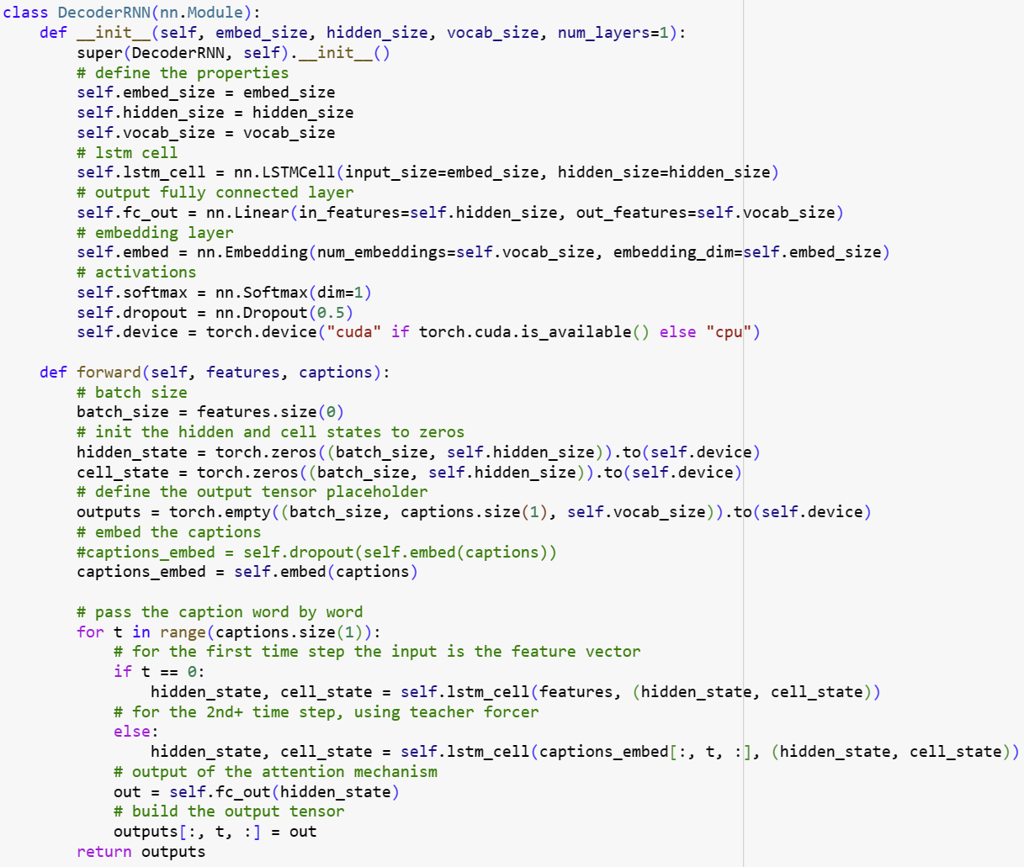
Current results so far
Task 2: Encoder-decoder architecture

Slide 18
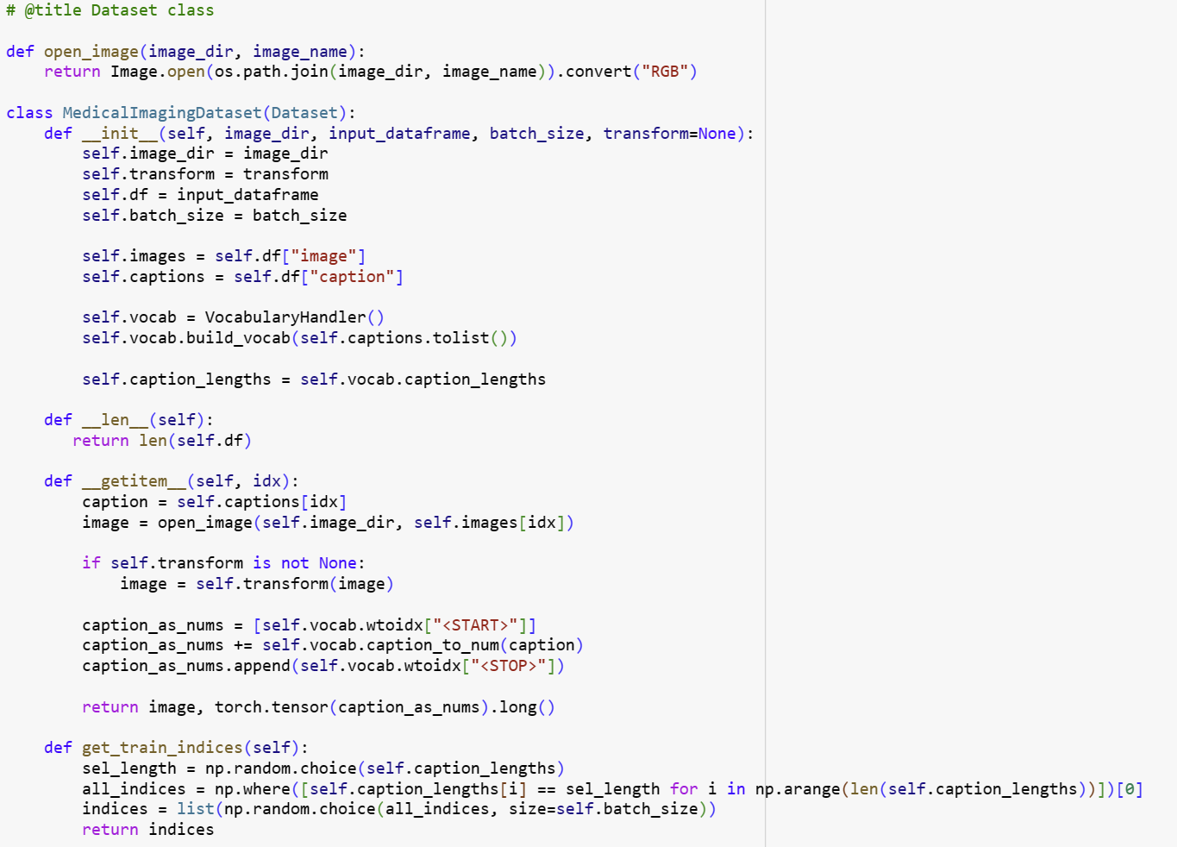
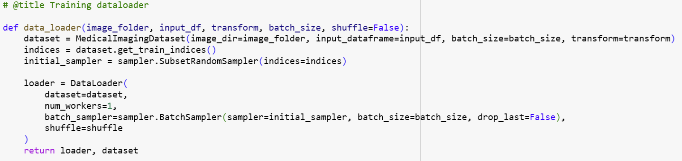
Current results so far
Task 4: Creating Data Loaders for Image and Caption Pairs.

Slide 19
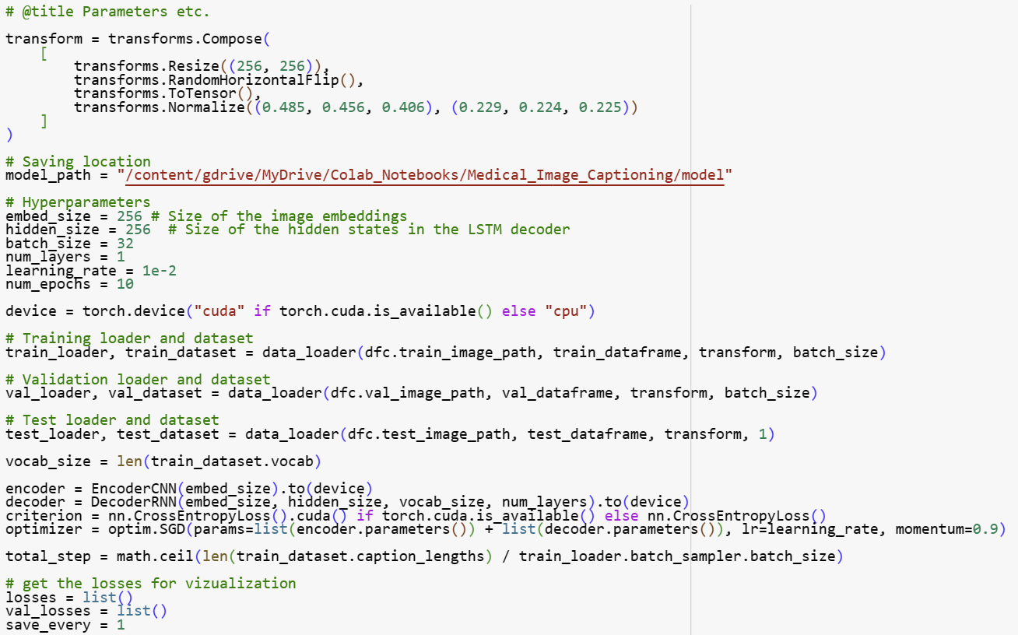
Current results so far
Task 5: Implementing and Training the Model on the ROCO Dataset

Slide 20
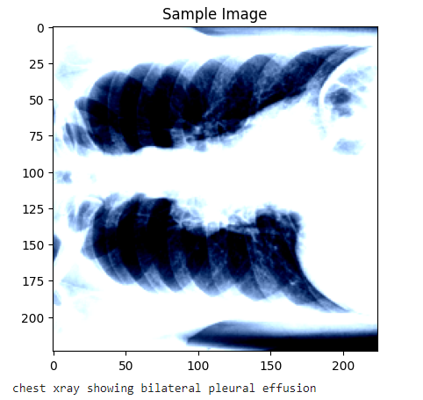
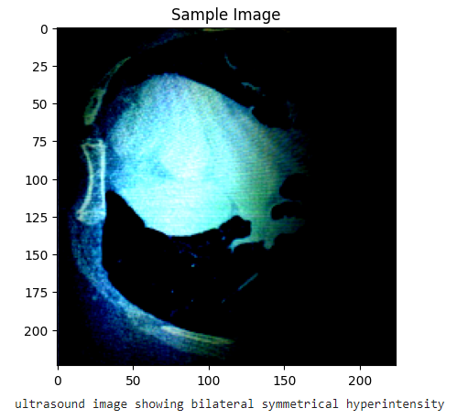
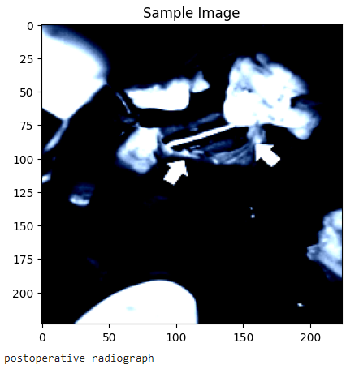
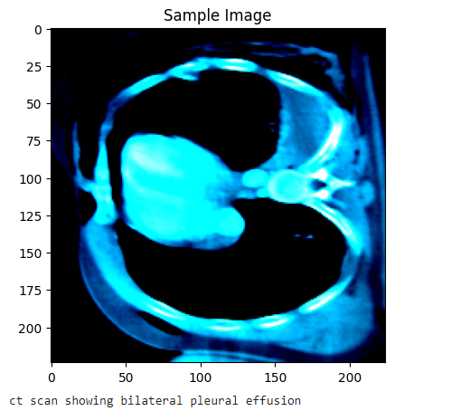
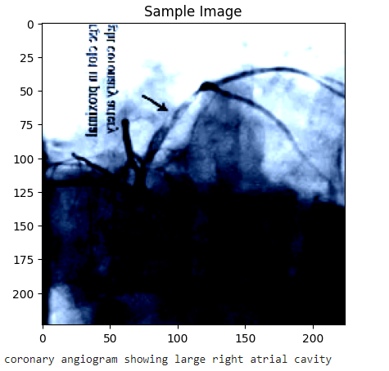
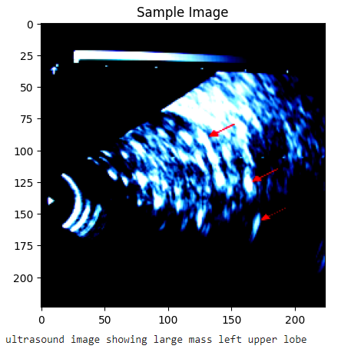
Current results so far
Task 6: Perform Model on Test Samples

Slide 21
Current results so far
Task 7: Model evaluation
YTBD

Slide 22
Current results so far
Task 8: Report writing
On going….

Slide 23
Thanks

